Slide 1
Natural Language Processing
OPER 785: Machine Learning II: Deep Learning
Lecture 10

Slide 2
Lesson Outline
Introduction
Goal Definition & Analysis
Building and Training Models
Corpus Analytics
Learning Models Exploration
Model Testing and Evaluation
Practical Examples Walkthrough

Slide 3


Slide 4
We use NLP Everyday
Grammarly, Microsoft Word
Search engines (Google, DuckDuckGo)
Voice assistants (Siri, Alexa)
Translations systems (Google Translator)
Job application filters
Sentiment Analysis
Chat bots

Slide 5
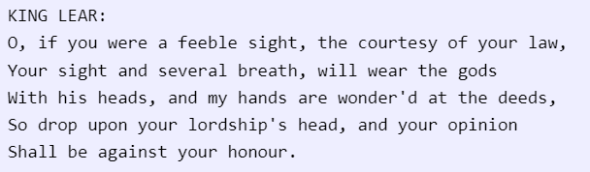
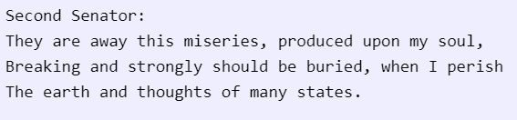
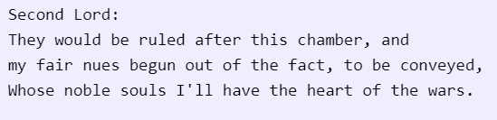
Shakespeare or Bot?
1.
2.
3.

Slide 6
NLP Challenges
Contextual Word Usage
I ran to the store because we ran out of milk.
Synonyms
Irony and Sarcasm
“Yeah, right”
Lexical/Semantic ambiguity
Interchangeable parts of speech (i.e., act, ice)
“I saw the boy on the beach with my binoculars”
Colloquial terms/phrases
Text/speech errors

Slide 7
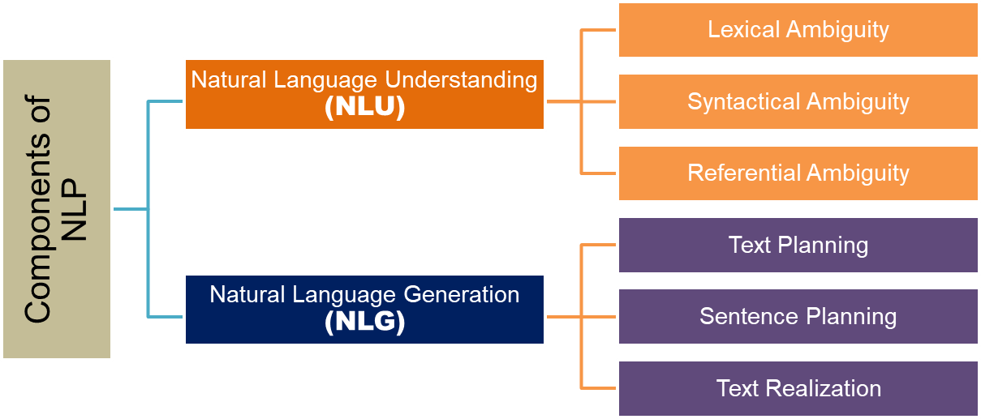
Natural Language Processing

Slide 8
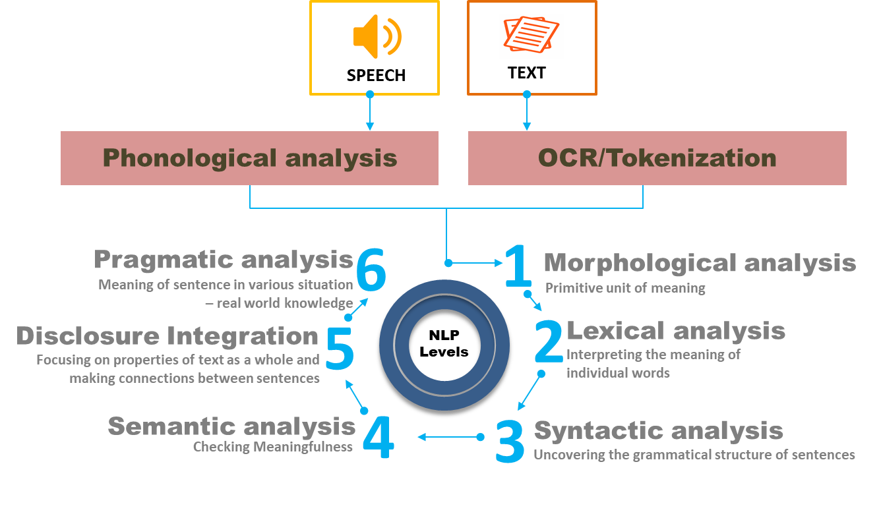
Natural Language Processing

Slide 9
Goal Definition
Statement of purpose
What the annotation will be used for
What the overall outcome of the annotation will be
Where the corpus will come from
How the outcome will be achieved
Goals may contain multiple annotation taskers

Slide 10
NLP Development Cycle
Model
Informed structural data assumptions and description
Annotate
Encode specific structural properties
Train
Test
Evaluate
Revise

Slide 11
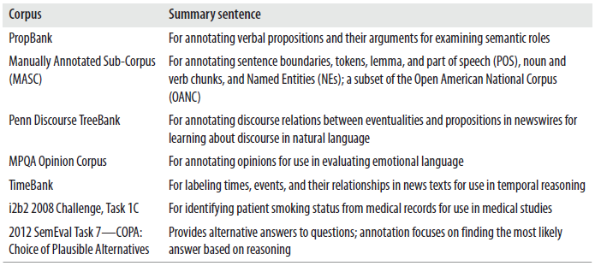
Background Research
Relevant corpus discovery
Linguistic Data Consortium (LDC)
Linguistic Resources and Evaluation (LRE) Map
Prior research/literature discovery

Slide 12
Basic Preprocessing
Minimize data complexity and noise
Tokenization of training data
Break down component data
Size/complexity varies
Paragraphs to words
Books to chapters or paragraphs
Removal of stop words
Low value/high frequency words
‘The’, ‘am’, ‘is’, etc.
Stemming/ Lemmatization
Reduce tokens to base form (if applicable)
‘Playing’, ‘Plays’, ‘Played’ might all reduce to ‘Play’
More sophisticated techniques like Porter’s Algorithm

Slide 13
Corpus Analytics Overview
Frequency of corpus components requires exploration
Corpuses unlikely to be balanced
Corpus Size (N)
The number of tokens in corpus
Vocabulary Size (V)
The number of unique tokens in corpus
Model N-Grams
Conditional probability tables of word placement
Improves prediction by introducing context

Slide 14
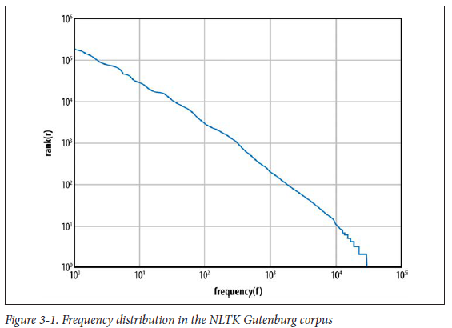
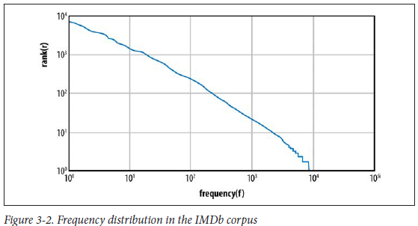
Corpus Analytics Overview

Slide 15

XML DTD Language Model
Extensible Markup Language Document Type Definition
Serves to define target tags and tag linkages
Enriches feature space for training dataset
Define Available Elements
<!Element verb (#PCDATA)>
Attribute declarations
<!ATTLIST verb tense (past | present | future | none)>
IMDB Dataset Example

Slide 16
Classifier Overviews
Decision Tree Classifiers
Series of questions
Interpretable, simple
Naive Bayes Classification
Series of conditional probabilities
Strong independence (naive) assumptions
k-NN Classifiers
Performs well with unannotated tokens
Well suited for machine translation
Support Vector Machines
Performs well with sentiment analysis
Robust with large feature set and small data set

Slide 17
Neural Networks in NLP
Neural networks may be applied towards NLP
RNN catered towards text prediction (NLG)
CNN good for finding general patterns and connections (NLU)
Text preprocessing required
One-hot encoding
Word embeddings
Vectorize tokens or groups of tokens
More detailed exploration in practical example

Slide 18
Model Evaluation Methods
Confusion Matrices
Compare true and false text classification
Confusion Matrices
Compare true and false text classification
Percentage Accuracy/Recall/Precision/Sensitivity
F-Score
Finds harmonic mean of precision and recall over a tag
May be used for general performance

Slide 19
NLP Evaluation Challenges
Small data set
Apply cross validation (K-Fold, LOOCV, etc.)
Model overfitting
Rebalancing corpus samples to be representative
Information crowding during annotation
Reduce redundant or less important tags
Uncertain model selection
Run and compare multiple models
May be good to have baseline regardless

Slide 20
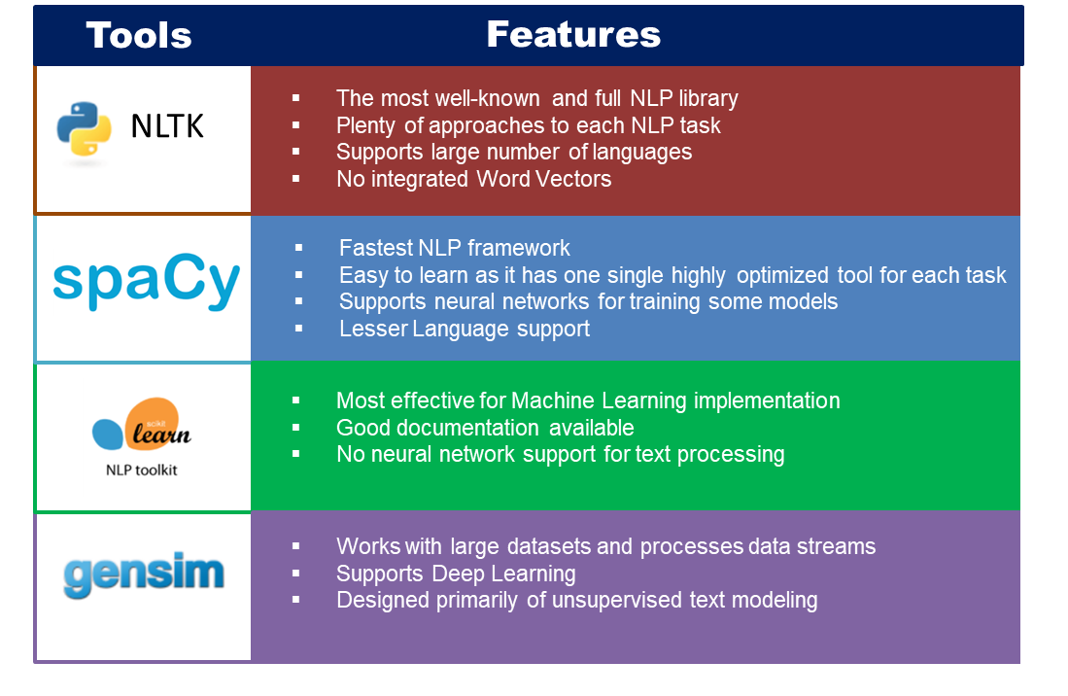
Tools for NLP
Notes:
Covering why LTSM models are not applicable

Slide 21
Sources
https://monkeylearn.com/blog/natural-language-processing-challenges/
https://www.ibm.com/blogs/watson/2020/11/nlp-vs-nlu-vs-nlg-the-differences-between-three-natural-language-processing-concepts/
Stubbs & Pustejovsky; Natural Language Annotation (2012)
https://datascience.foundation/sciencewhitepaper/natural-language-processing-nlp-simplified-a-step-by-step-guide
https://realpython.com/python-keras-text-classification/#further-reading
https://realpython.com/nltk-nlp-python/
http://snowball.tartarus.org/algorithms/porter/stemmer.html
http://karpathy.github.io/2015/05/21/rnn-effectiveness/

Slide 22
Questions

